Slide 1
Digital System

Slide 2
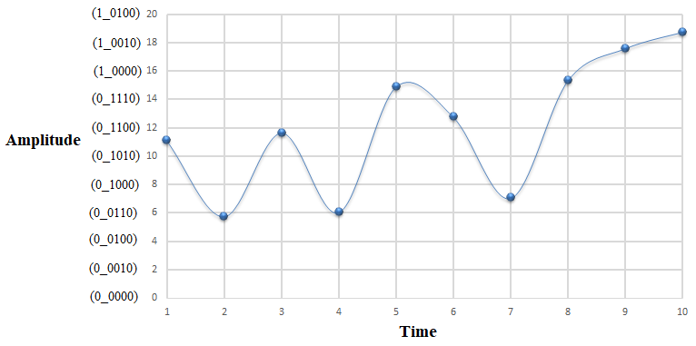
Digital Signal Representation
High Precision – Higher number of bits required
Notes:
Byte – 8 bits, a standard now since 1956!
Bit
12-bit, 20-bit were also present

Slide 3
Digital Signal Representation
Binary digit represents – logic HIGH or logic LOW
In an electronic system – logic HIGH is 1, logic LOW is 0 or vice-versa
1 bit represents – 2 states
2 bits represents – 4 states – {00,01,10,11}
n bits represents – 2^{n} states
2¹⁰ = 1024 ~ 1K bits
2²⁰ = 10,48,576 ~ 1M bits

Slide 4
Analog and Digital Systems
Analog systems process analog signals which can take any value within a range
Microphone, Analog meter display
Digital systems process digital signals which can take only a limited number of values between two values
Flip-flops, Shift registers, Digital display

Slide 5
Advantage and Disadvantages of Digital Systems
High accuracy (+)
Programmability (+)
Maintainability (+)
Design Automation (+)
Area, Power, Performance (-)

Slide 6
Introduction
Rise in functionality increase design complexity
So, post design steps are automated using Computer Aided Design (CAD) tools
However, even designs using automated CAD tools may have bugs
Due to extremely large size of the design space it is not possible to verify correctness of the design under all possible situations
Techniques that can verify, without exercising exhaustive input-output combinations, that the design meets all the input specifications - formal verification

Slide 7
Introduction
Manufacturing defect could arise due to decrease in the inter-component distance
All the chips need to be physically tested by giving input signals from a pattern generator and comparing responses using a logic analyzer - testing.
In the process of manufacturing a VLSI IC there are three broad steps
Design
Verification
Test
Categorization of the IC’s can be done based on the functionality
Analog, Digital or Mixed-signal
Analog IC
Ex: Current mirrors, Voltage followers, filters, OPAMPs etc. work by processing continuous signals.
They perform functions like amplification, active filtering, demodulation etc.
Digital IC
Ex: logic gates, flip-flops, multiplexers, and other circuits which work using binary mathematics to process "one" and "zero" signals.
Mixed Signal IC
Ex: Analog to Digital Converter (ADC)

Slide 8
Introduction
Automation algorithms and CAD tools are mainly available for digital ICs
Digital circuits comprise millions of components and transformation of design specifications to silicon implementation can be accomplished using logical procedures
Most of the analog circuits comprise less than hundred devices and its design is like an “art” which is best performed by designers with “aid” of some CAD tools

Slide 9
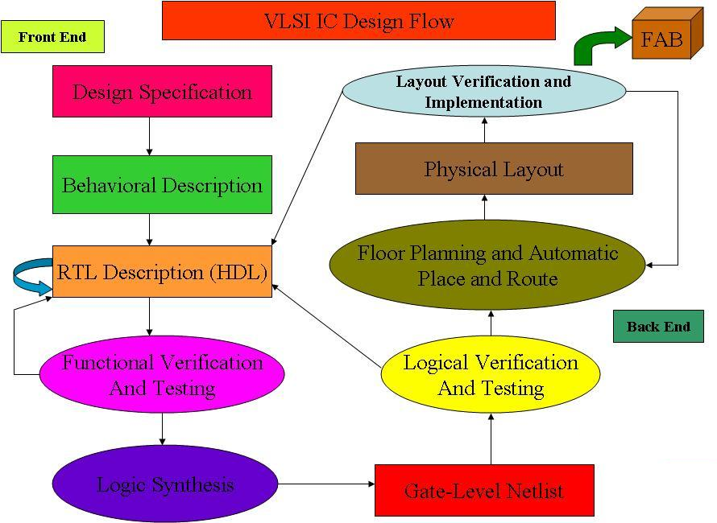
Introduction

Slide 10
Design Abstraction Levels
Introduction
SYSTEM
MODULE
+
GATE
CIRCUIT
DEVICE
G
S
D
n+
n+

Slide 11
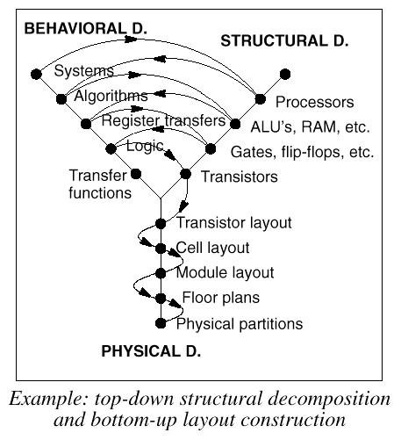
Introduction

Slide 12
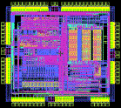
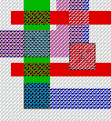
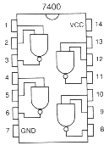
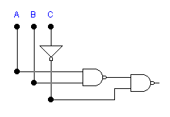
Introduction
Top-down design - Design complex circuits in a simple way
Architecture
Components
Gates
Transistors
Layout
IC
F=AB+C
Bottom-up analysis – Analyze simple components in a complex way

Slide 13
Introduction
Functionality of electronics equipment and gadgets has increased but their physical size has come down drastically
Due to the rapid advances in integration technologies - millions of transistors in a single Integrated Circuit (IC) or chip.
Small Scale Integration (SSI) - integration with 10's of transistors
Medium Scale Integration (MSI) - integration with 100's of transistors
Large Scale Integration (LSI) - integration with 1000's of transistors
Very Large Scale Integration (VLSI) - integration with 1000's of transistors

